Slide 1

Final Project DATA 602: Introduction to Data Analysis and Machine Learning UMBC
Dishant Fapot

Slide 2

DISEASE Prediction using EMR (Electronic Medical Report)

Slide 3
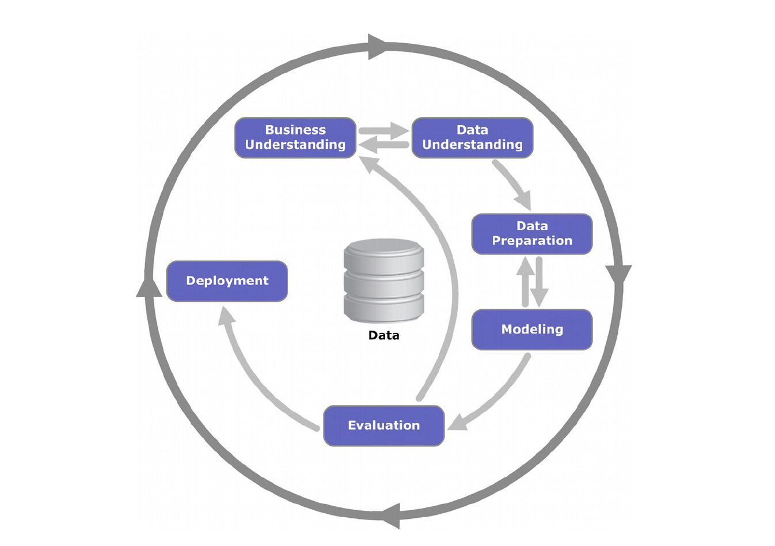
What is this project about?
Business understanding:
Due to confidentiality reasons accessing the original patients data was not possible hence, we are using artificially generated EMR.
Electronic medical records (EMRs) represent a powerful resource to study disease complications at a population level.
Recent studies have demonstrated the usefulness of EMR analysis for discovering or confirming outcome correlations, subcategories of disease.
Notes:
The whole idea was to do something in the health sector, so we wanted to get health data but due to confidentiality issues we weren’t able to get the data of the patients hence we are using the EMR

Slide 4
Objective of the project
To be able to predict the generic diseases from the given primary diagnostic data
Predicting the age of the patient
Predicting Lab test type

Slide 5

Data understanding
Data collection: using the EMR record
Describe data
Explore data

Slide 6
What does our data look like?
Used 4 datasets:
Patients Data – demographics(i.e. DOB, Gender, Status)
Admission Data(i.e. Admission start and end date)
Lab Data(i.e. lab name(type of tests))
Diagnosis Data(i.e. primary diagnosis code and description)

Slide 7
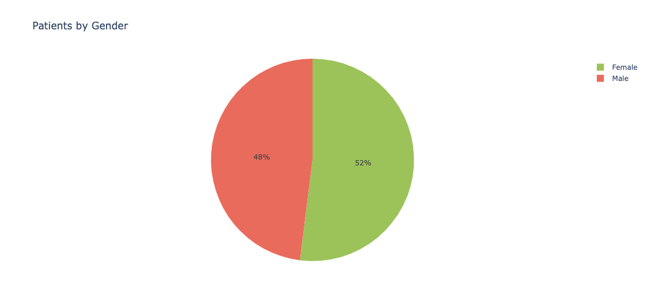
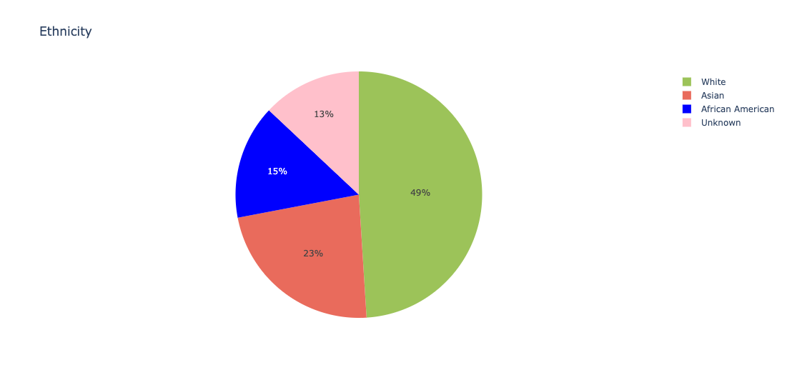
Exploratory analysis
There are more female patients than Male.
In terms of ethnicity the White population is most followed by Asian.

Slide 8
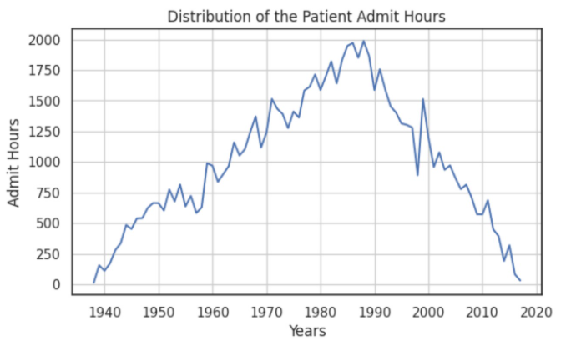
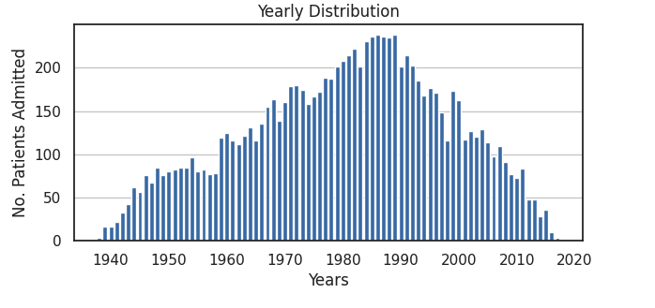
Number of Patient Admission and Admit Hours Distribution
No. of patients admitted sees a peak during the 1980’s to 1990. There after sees a decrease.
Total Admit hours of all the patients was on peak in 1988. We can see it plummeting after that.

Slide 9
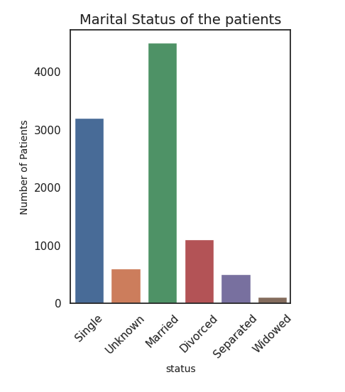
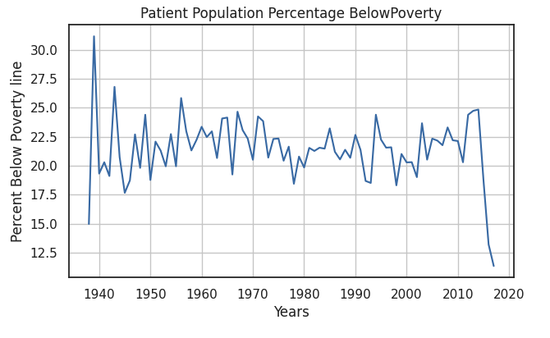
The patient's poverty is seen to be fluctuating but there is a significant drop after a rise in 2012.
We can see that more than half the patients are married

Slide 10
Data Preparation and preprocessing
Prepare data
Extract/ converting data: OHE
Integrate data : aggregated multi-tables to a single table
Notes:
For formatting: mention number of train and test data

Slide 11
Data Preparation and preprocessing
Construct data:
Since the dataset didn’t have symptoms and only had the diagnosis code,
we fetched data to get potential diseases categories and mapped them according to the patient using common keywords.
Created a new column of disease type(disease name) for the prediction.
Clean and select the data: features selection, data sampling
Chose target variables: Age, test(lab type), disease type
Formatting the data : preparing data sets for training testing and validation

Slide 12

Modeling phase
Select the modeling techniques:
Build models
What we have used:
Kneighbors Classifier
Linear Regression
SVM
Notes:
In this mention : for which we have done what
Patients age: used linear regression on test data of ……(around 80000)

Slide 13
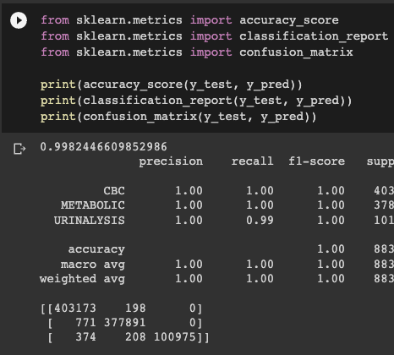
Evaluation
Evaluate the result:
Model accuracy-
Predicting the lab test accuracy: 0.998
Predicting the age of patient accuracy: R2 score 1.0
Deployed KNN and Random Forest model
Review process
Determine next steps
Fig: Lab test accuracy using Kneighbors classifier

Slide 14

Evaluation
To check if the model was over or underfit – we computed the error (mae) and the difference between train and test dataset was negligible.
We also computed avg bias and variance for both training and test dataset and both the values were zero, which is good as it reflects that the model is accurate.

Slide 15
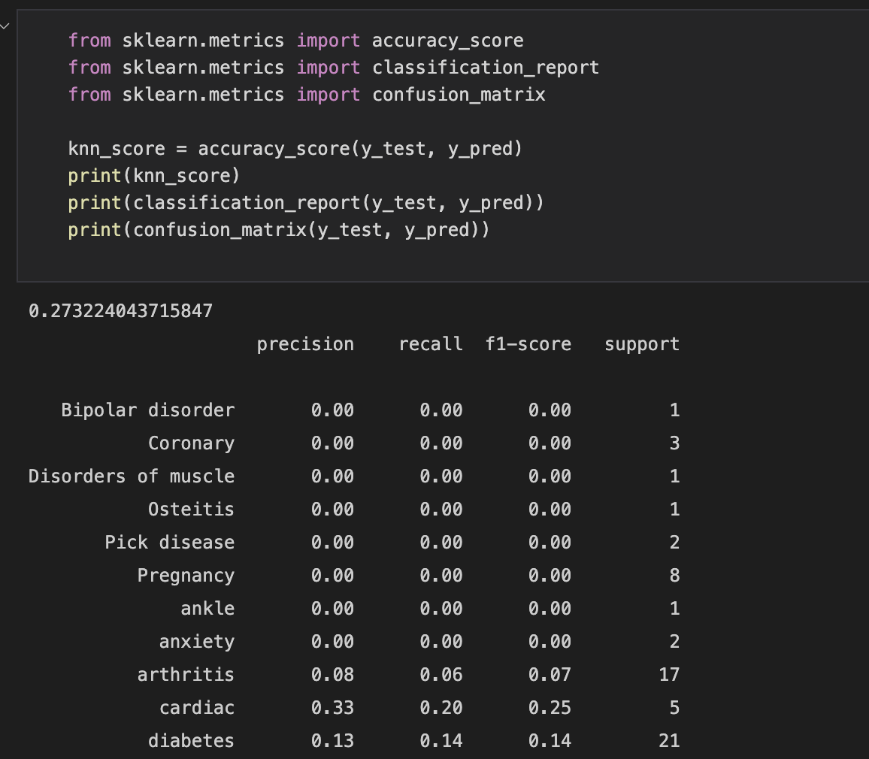
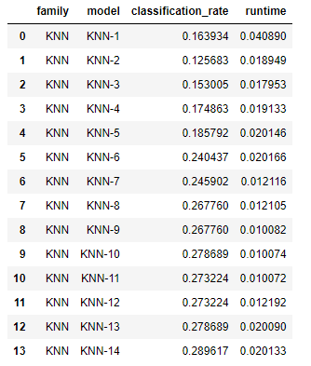
Predicting using KNN
Fig: Diseases Prediction accuracy using Kneighbors Classifier (0.29) when K=14

Slide 16
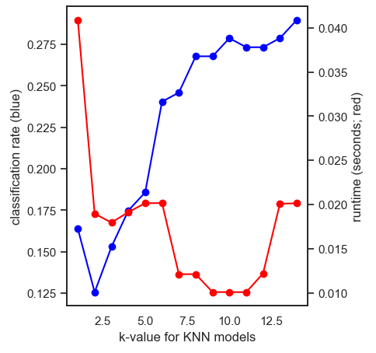
Evaluation
Evaluate the result:
The runtime for the most accurate classification rate is low.
i.e. for classification rate of 0.278, run time is 0.013
Fig: Line chart to show the runtime and classification rates

Slide 17
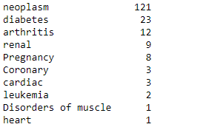
Disease Predicted using KNN

Slide 18
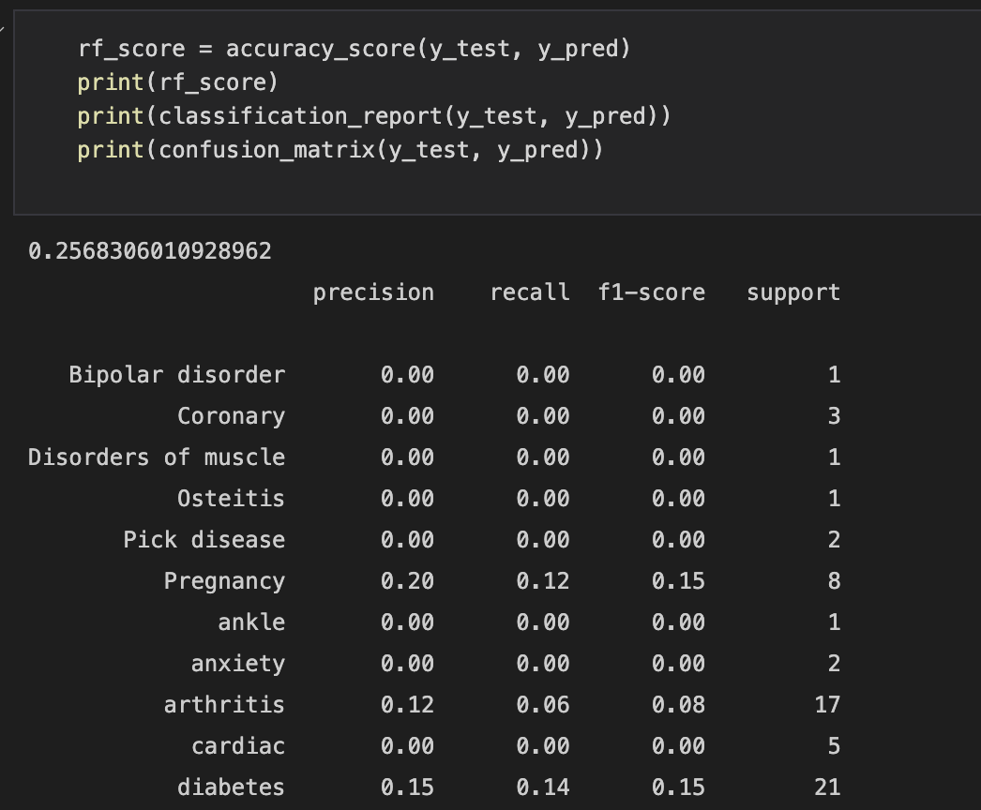
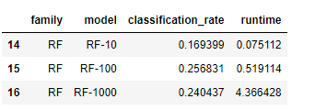
Prediction using RF
Evaluate the result:
The accuracy of disease prediction using random forest is 0.256 when the RF n_estimator value is 100
Fig: Accuracy of the disease prediction using random forest(0.25)

Slide 19
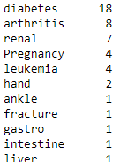
Disease Predicted using Random Forest

Slide 20

Prediction using SVM
For SVM, we fine tuned the model using hyperparameters and shown below is our best estimators.
With this best estimator, our model accuracy was 32.2%

Slide 21
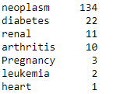
Disease Predicted using SVM

Slide 22
Best Model
Out of the different algorithms we can see that the highest accuracy is attained while using SVM.

Slide 23

Determining the next steps
Further in the project we can try to increase the accuracy of the model, optimize for better accuracy.
Scope to use a pre-trained model such as the BART zero classifier to ensure and compare result to golden standards.

Slide 24
References:
Niaksu, Olegas. (2015). CRISP Data Mining Methodology Extension for Medical Domain. Baltic J. Modern Computing. 3. 92-109.
Schwartz, J. T., Gao, M., Geng, E. A., Mody, K. S., Mikhail, C. M., & Cho, S. K. (2019). Applications of Machine Learning Using Electronic Medical Records in Spine Surgery. Neurospine, 16(4), 643–653. https://doi.org/10.14245/ns.1938386.193
A Methodology to Generate Virtual Patient Repositories Uri Kartoun PhD, Massachusetts General Hospital / Harvard Medical School

